Slide 1

Python
MatplotLib

Slide 2

MatplotLib
Matplotlib is one of the most popular Python packages used for data visualization.
Cross-platform library for making 2D plots from data in arrays.
Provides an object-oriented API that helps in embedding plots in Applications using Python GUI toolkits such as PyQt, WxPythonotTkinter.
Allows visual access to huge amounts of data in digestible visual
www.skillslash.com

Slide 3
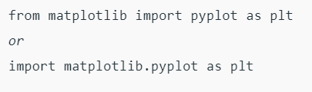
Import matplotlib
www.skillslash.com

Slide 4
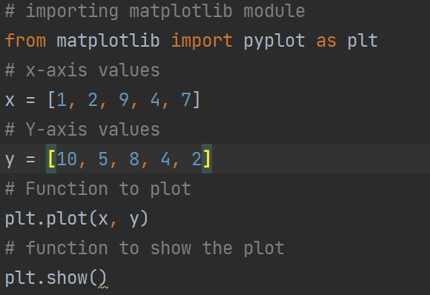
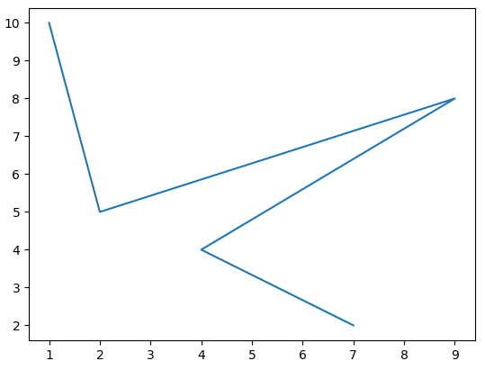
Line plots

Slide 5
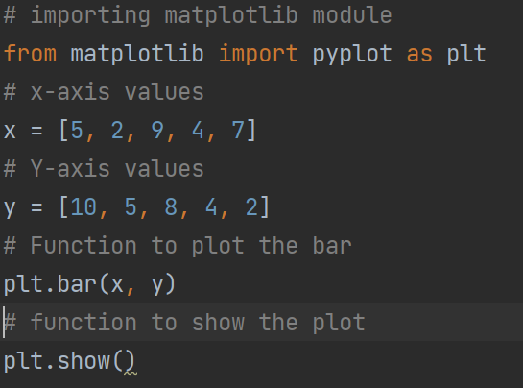
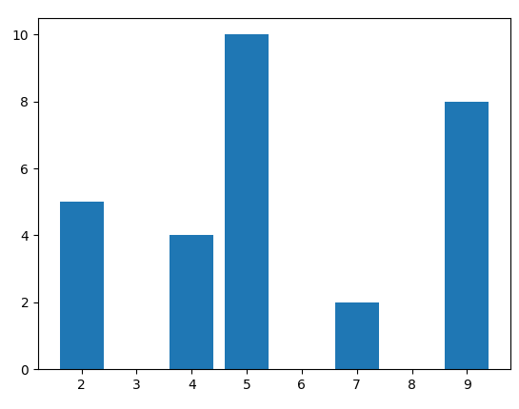
Bar Plots

Slide 6
Histogram and Bar plot difference
A bar graph is the graphical representation of categorical data using rectangular bars where the length of each bar is proportional to the value they represent.
A histogram is the graphical representation of data where data is grouped into continuous number ranges and each range corresponds to a vertical bar.

Slide 7
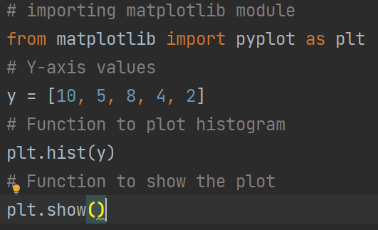
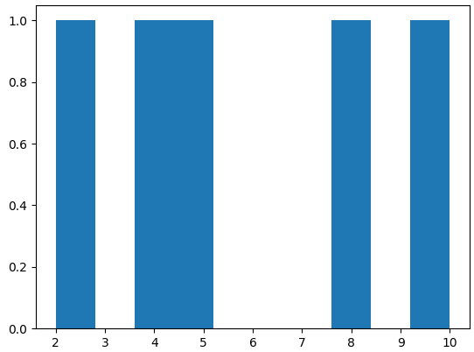
Histogram Plots

Slide 8
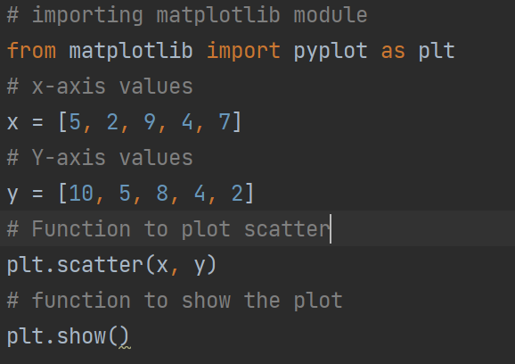
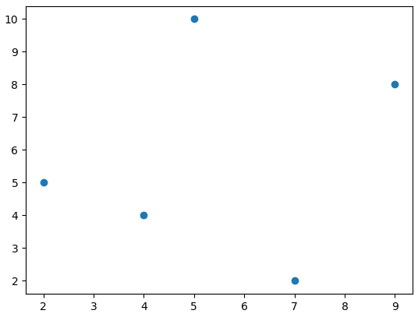
Scatter Plots

Slide 9
Figures and Axes
The matplotlib.figure module contains the Figure class.
It is a top-level container for all plot elements.
The Figure object is instantiated by calling the figure() function from the pyplot module −
fig = plt.figure()
Axes object is the region of the image with the data space.
A given figure can contain many Axes, but a given Axes object can only be in one Figure.
The Axes contains two (or three in the case of 3D) Axis objects.

Slide 10
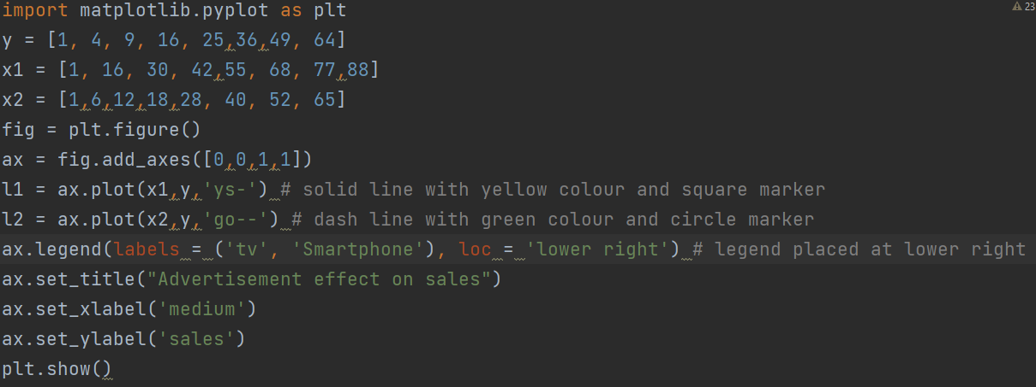
Notes:
Last 2 coordinates (1,1) shows the panning so if you make 0.5 0.5 it will make it small
00-> bottom left, 1,1 -> top right
import matplotlib.pyplot as plt y = [1, 4, 9, 16, 25,36,49, 64] x1 = [1, 16, 30, 42,55, 68, 77,88] x2 = [1,6,12,18,28, 40, 52, 65] fig = plt.figure() ax = fig.add_axes([0,0,1,1]) l1 = ax.plot(x1,y,'ys-') # solid line with yellow colour and square marker l2 = ax.plot(x2,y,'go--') # dash line with green colour and circle marker ax.legend(labels = ('tv', 'Smartphone'), loc = 'lower right') # legend placed at lower right ax.set_title("Advertisement effect on sales") ax.set_xlabel('medium') ax.set_ylabel('sales') plt.show()

Slide 11
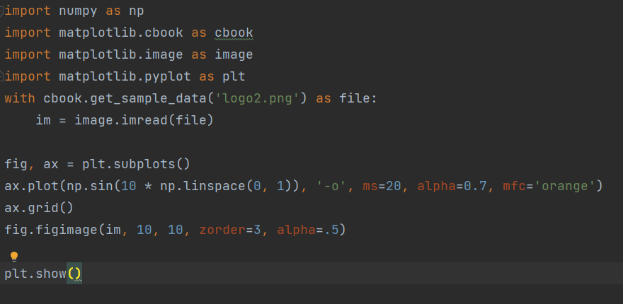
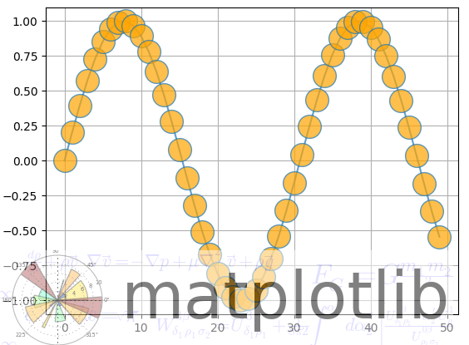
WaterMark

Slide 12
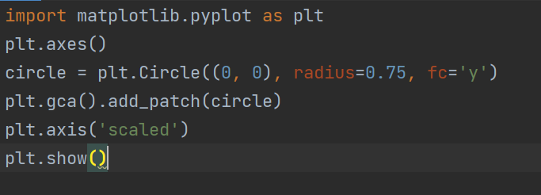
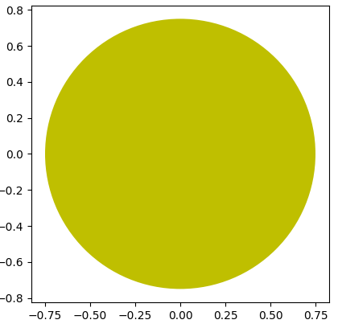
Shapes

Slide 13
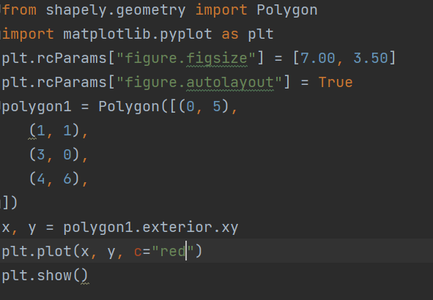
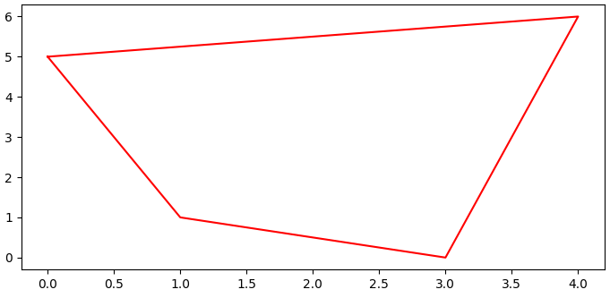
Polygon and Arrows

Slide 14
Polygon and Arrows
Notes:
from shapely.geometry import Polygon plt.rcParams["figure.figsize"] = [7.00,3.50] plt.rcParams["figure.autolayout"] = True polygon1 = Polygon([(0,5),(1,1),(3,0),(4,6)]) x,y = polygon1.exterior.xy plt.plot(x,y,c="red") plt.show()

Slide 15
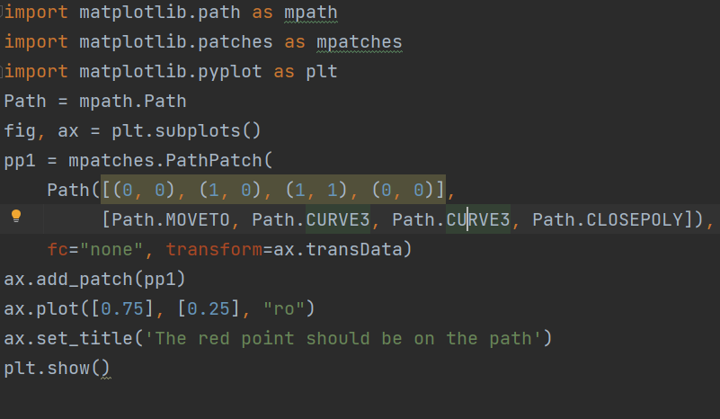
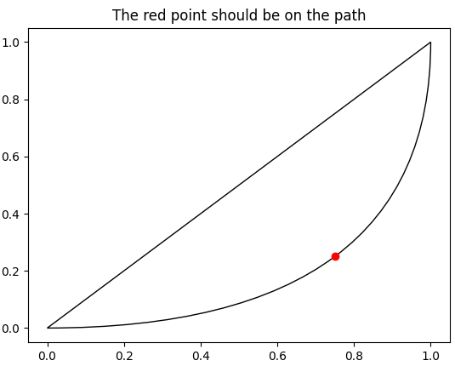
Beizer Curves

Slide 16
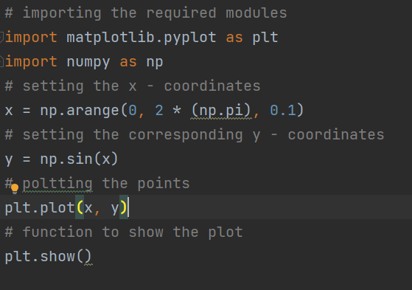
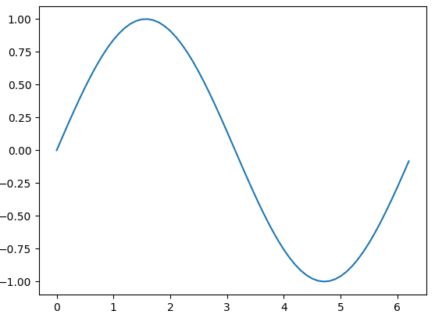
Curves

Slide 17
Annotations
The annotate() function in pyplot module of matplotlib library is used to annotate the point xy with text s.
Syntax: angle_spectrum(x, Fs=2, Fc=0, window=mlab.window_hanning, pad_to=None, sides=’default’, **kwargs)
Parameters: This method accept the following parameters that are described below:
s: This parameter is the text of the annotation.
xy: This parameter is the point (x, y) to annotate.
xytext: This parameter is an optional parameter. It is The position (x, y) to place the text at.
xycoords: This parameter is also an optional parameter and contains the string value.
textcoords: This parameter contains the string value.Coordinate system that xytext is given, which may be different than the coordinate system used for xy
arrowprops : This parameter is also an optional parameter and contains dict type.Its default value is None.
annotation_clip : This parameter is also an optional parameter and contains boolean value.Its default value is None which behaves as True.
Returns: This method returns the annotation.

Slide 18
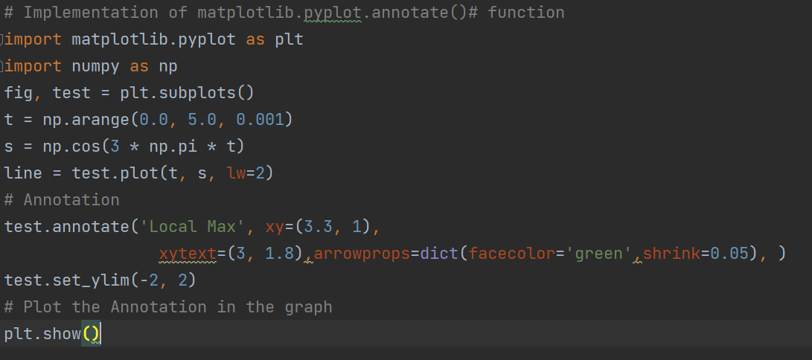

Slide 19
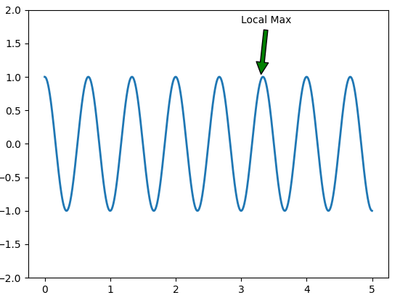

Slide 20
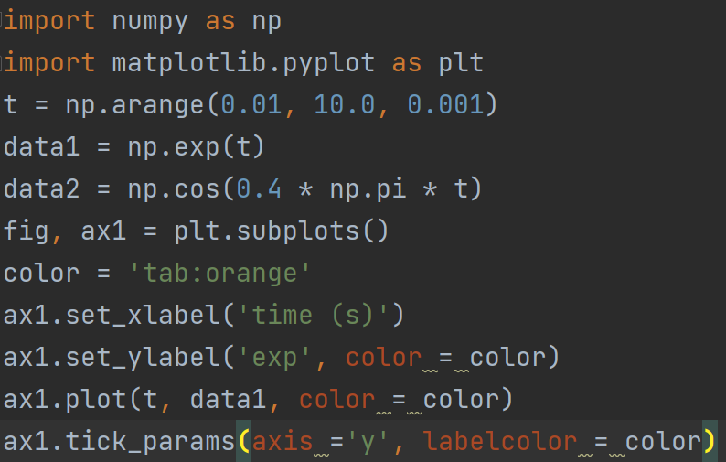
Scales and Twin Axis
Notes:
import numpy as np import matplotlib.pyplot as plt t = np.arange(0.01, 10.0, 0.001) data1 = np.exp(t) data2 = np.cos(0.4 * np.pi * t) fig, ax1 = plt.subplots() color = 'tab:orange' ax1.set_xlabel('time (s)') ax1.set_ylabel('exp', color = color) ax1.plot(t, data1, color = color) ax1.tick_params(axis ='y', labelcolor = color) ax2 = ax1.twinx() color = 'tab:cyan' ax2.set_ylabel('cos', color = color) ax2.plot(t, data2, color = color) ax2.tick_params(axis ='y', labelcolor = color) fig.suptitle('matplotlib.axes.Axes.twinx()function Example\n\n', fontweight ="bold") plt.show()

Slide 21
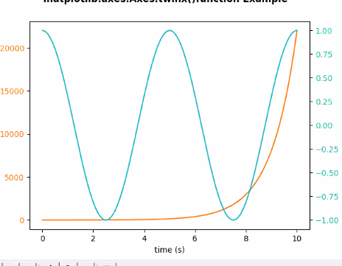

Slide 22
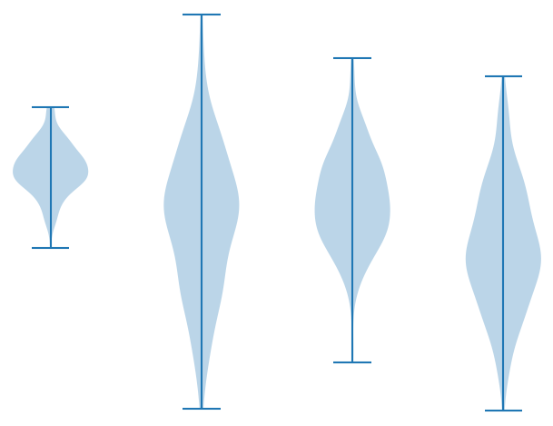
Boxplot and Violin Plots
import matplotlib.pyplot as plt
import numpy as np
np.random.seed(10)
collectn_1 = np.random.normal(100, 10, 200)
collectn_2 = np.random.normal(80, 30, 200)
collectn_3 = np.random.normal(90, 20, 200)
collectn_4 = np.random.normal(70, 25, 200)
## combine these different collections into a list
data_to_plot = [collectn_1, collectn_2, collectn_3, collectn_4]
# Create a figure instance
fig = plt.figure()
# Create an axes instance
ax = fig.add_axes([0,0,1,1])
# Create the boxplot
bp = ax.violinplot(data_to_plot)
plt.show()

Slide 23
Visualize Titanic Dataset with Box and Violin plots
https://towardsdatascience.com/predicting-the-survival-of-titanic-passengers-30870ccc7e8

Slide 24
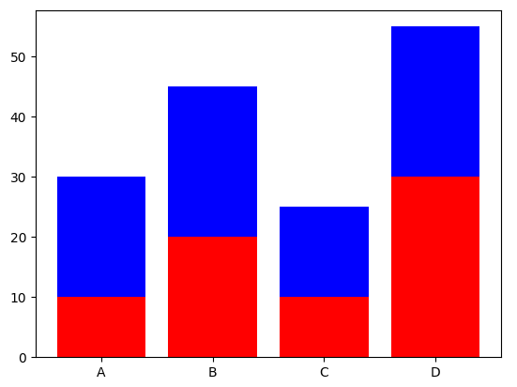
Stacked Plots
# importing package
import matplotlib.pyplot as plt
# create data
x = ['A', 'B', 'C', 'D']
y1 = [10, 20, 10, 30]
y2 = [20, 25, 15, 25]
# plot bars in stack manner
plt.bar(x, y1, color='r')
plt.bar(x, y2, bottom=y1, color='b')
plt.show()

Slide 25
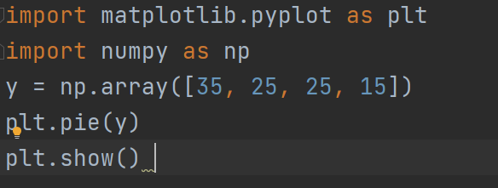
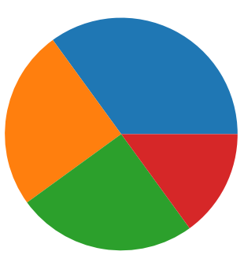
Pie Charts

Slide 26
Color Maps
import matplotlib.pyplot as plt
plt.style.use('classic')
import numpy as np
x = np.linspace(0, 10, 1000)
I = np.sin(x) * np.cos(x[:, np.newaxis])
plt.imshow(I)
plt.colorbar();

Slide 27
Autocorrelation
Autocorrelation plots are a commonly used tool for checking randomness in a data set. This randomness is ascertained by computing autocorrelations for data values at varying time lags.
It measures a set of current values against a set of past values and finds whether they correlate.
It is the correlation of one-time series data to another time series data which has a time lag.
It varies from +1 to -1.
An autocorrelation of +1 indicates that if time series one increases in value the time series 2 also increases in proportion to the change in time series 1.
An autocorrelation of -1 indicates that if time series one increases in value the time series 2 decreases in proportion to the change in time series 1.

Slide 28
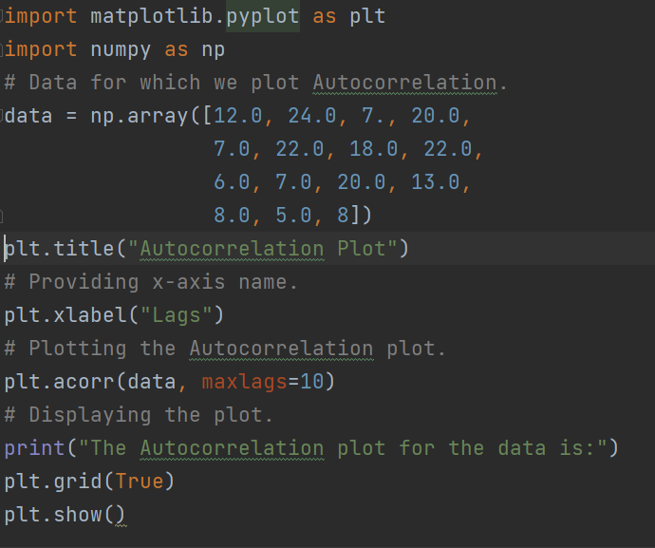
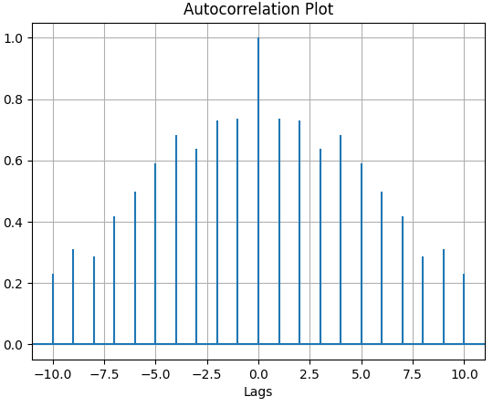

Slide 29
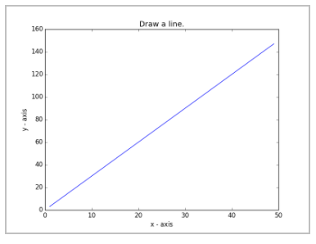
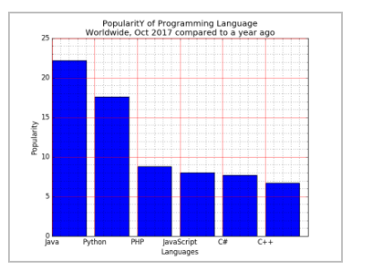
Exercise 1:
Write a Python programming to display a bar chart of the popularity of programming Languages. Sample data: Programming languages: Java, Python, PHP, JavaScript, C#, C++ Popularity: 22.2, 17.6, 8.8, 8, 7.7, 6.7 The code snippet gives the output shown in the following screenshot:
Notes:
import matplotlib.pyplot as plt import numpy as np x = np.array([10, 20, 30, 40, 50, 60]) y = np.array([0, 20, 40, 60, 80, 100]) plt.plot(x, y) plt.xlabel("X-axis") plt.ylabel("Y-axis") plt.title("Draw a line") plt.show()

Slide 30
Exercise 2:
Write a Python programming to display a bar chart of the popularity of programming Languages. Sample data: Programming languages: Java, Python, PHP, JavaScript, C#, C++ Popularity: 22.2, 17.6, 8.8, 8, 7.7, 6.7 The code snippet gives the output shown in the following screenshot:
Notes:
import matplotlib.pyplot as plt import numpy as np x = np.array(['Java', 'Python', 'PHP', 'JavaScript', 'C#', 'C++']) y = np.array([22.2, 17.6, 8.8, 8, 8.7, 6.7]) plt.bar(x, y) plt.xlabel("Languages") plt.ylabel("Popularity") plt.title("Popularity of Programming Languages Worldwide,\nOct 2017 compared to a year ago") plt.show()

Slide 31
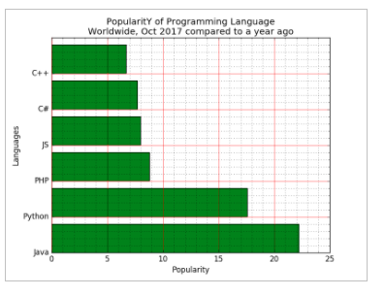

Slide 32
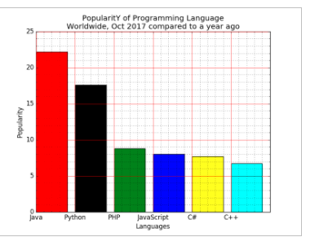

Slide 33
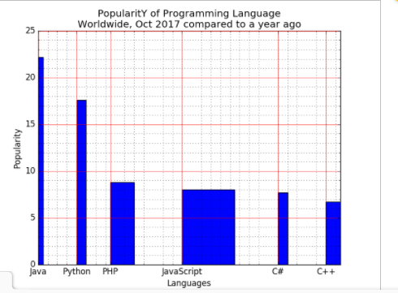

Slide 34
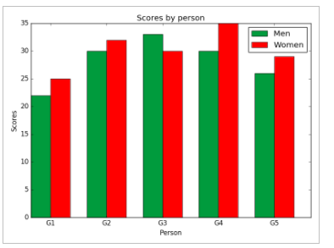

Slide 35
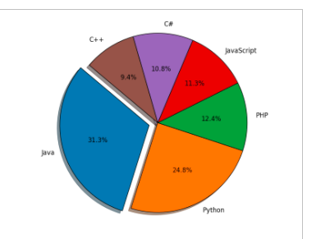

Slide 36
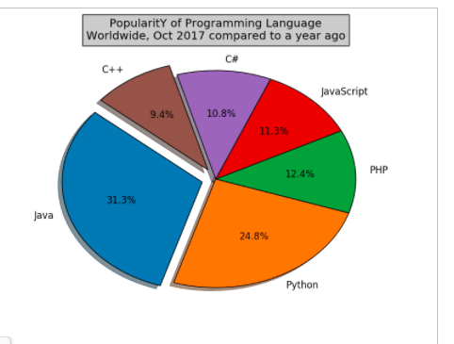

Slide 37
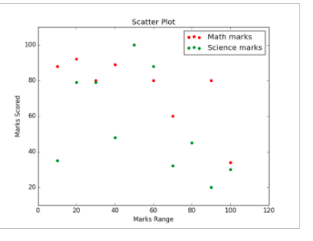

Slide 38
THANK YOU
www.skillslash.com

